Slide 1
Introduction to FPGAs Lecture 1: FPGAs, Logic Gates, Programming an FPGA
Adam Duncan Ph.D.

Slide 2
Class Introduction
About Me: Electrical/Computer Engineer at NSWC Crane
Class Goals: 1) Learn about FPGAs. 2) Program FPGAs to do fun things.
Class SW Materials: https://github.com/adamdunc/whs

Slide 3
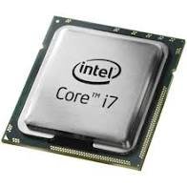
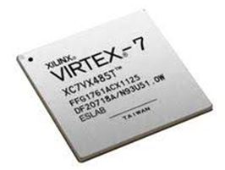
Field-Programmable Gate Arrays (FPGAs) are “Programmable Hardware” devices
CPU
~1 inch² with ~10 billion transistors
Fast (~3GHz)
Hardware does one thing really well (execute code)
FPGA
~1 inch² with ~10 billion transistors
Not as Fast (~500MHz)
Hardware can be programmed to do anything

Slide 4

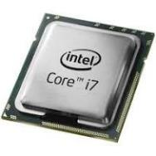
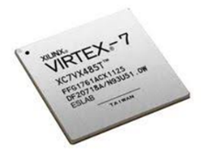
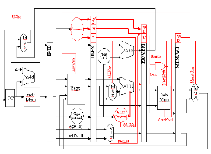
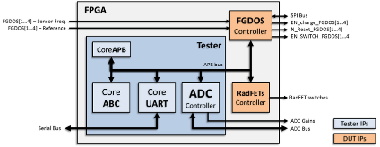
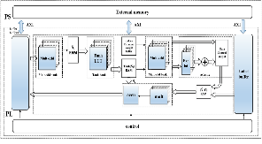
FPGA hardware behavior configured by “Bitstream” file
Custom
Sensor
Bitstream
Neutral Network
Bitstream
CPU
Bitstream
CPU
FPGA
CPU is always CPU Datapath
FPGA is now customized sensor driver/sampler
FPGA is now Neural Network Datapath
FPGA is now CPU Datapath

Slide 5
FPGA benefits
HW ultimately drives performance (SW optimizations limited by HW)
Parallelization (i.e. 35 parallel ALUs executing at same time)
Unique needs (read non-standard sensors at deterministic time intervals)
Consolidates PCB circuitry (CPU + sensor logic + display driving)
Prototype Custom Integrated Circuits (wafers >$10M)
Update hardware in field (security updates, new features, bug fixes)
Replace obsolete hardware (configure FPGA to “emulate” obsolete component”

Slide 6

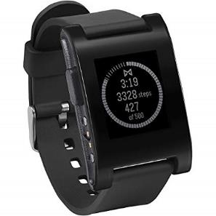



FPGAs in the Wild
Ease of use:
New HW designs in ~1 day
Design portability
Cost:
$1 for low-cost FPGAs
$100K for rugged/large FPGAs
Products with FPGAs:
Consumer electronics
DoD Programs
Automotive
Networking equipment
Test/Measurement equipment

Slide 7

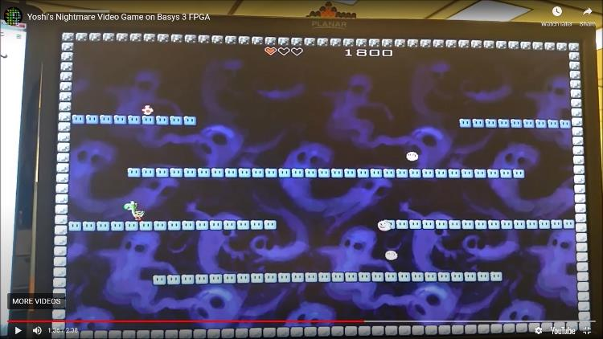

FPGA Demo: Yoshi’s Nightmare on our class FPGA
NES Classic Circuit Board
FPGA replacing CPU/GPU, RAM, Flash
We can configure the FPGA to emulate video game system driving a display
https://github.com/jconenna/Yoshis-Nightmare

Slide 8
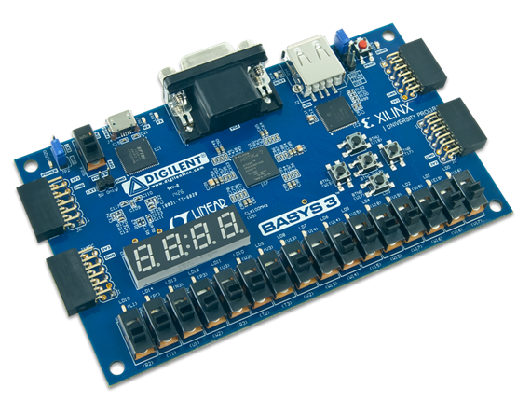
Meet Our FPGA: Xilinx Artix7 on a BASYS3 PCB
VGA
Pushbuttons
USB/UART
Xilinx Artix7 FPGA with 35K gates
LEDs
Slide Switches
7-segment LEDs
https://reference.digilentinc.com/basys3/refmanual

Slide 9
This week we design/simulate/program an FPGA!
Monday:
(morning) Project 0: Program your FPGA with a pre-made file to play “Yoshi’s Nightmare”
(morning) Project 1: Build a half adder circuit with logic gates on a breadboard
(afternoon) Project 2: Design/Program your FPGA to behave like a half adder
(afternoon) Project 3: Simulate your half adder project
Tuesday:
Project 4: Design/Simulate/Program your FPGA to behave as a calculator
Project 5: Design/(Simulate)/Program your FPGA to behave as a UART to communicate with your computer.
Wednesday:
Project 6.0: Design/(Simulate)/Program your FPGA to play basic Pong
Project 6.1: Add Pong features: scoring, keyboard control, sounds, etc
Thursday:
Project 6.1 continued: Add more Pong features: scoring, keyboard control, sounds, etc
Friday
Project Brief Outs

Slide 10
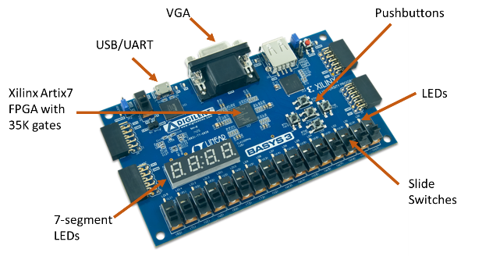
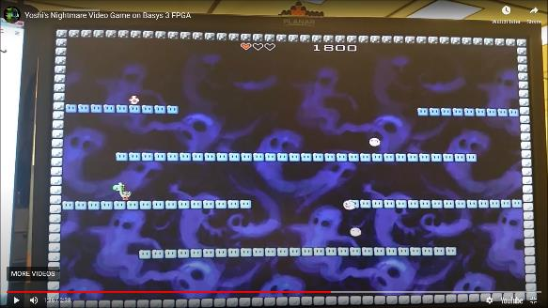
Project 0: Program FPGA to Play Yoshi’s Nightmare in 7 Easy Steps!
Open Vivado on laptop
Connect BASYS3 to laptop with micro-usb cable
Connect BASYS3 to monitor with VGA cable
Open Hardware Manager in Vivado
Click “autoconnect”
Select Program File “nightmare.bit”
Click “Program”
Use center pushbutton to start game
Use left/right/up pushbutton to move Yoshi
Try to score more than 620 points
Project 0 Goals:
Run Vivado FPGA EDA software
Program FPGA to do something

Slide 11
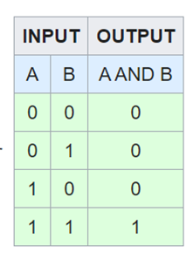
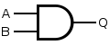
FPGA hardware behavior controlled by “logic gates” that implement Boolean equations
FPGAs contain up to 20 million logic gates!
“AND” logic gate
https://en.wikipedia.org/wiki/Logic_gate

Slide 12
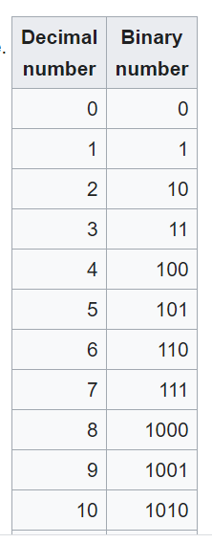
Project 1: Add two binary numbers (half adder) with logic gates on a breadboard
Decimal to binary conversion
Half Adder
(Decimal)
0 + 0 = 0
0 + 1 = 1
1 + 0 = 1
1 + 1 = 2
Half Adder
(Binary)
0 + 0 = 00
0 + 1 = 01
1 + 0 = 01
1 + 1 = 10
Project 1 Goals:
Learn about logic gates
Build a physical circuit with logic gates

Slide 13
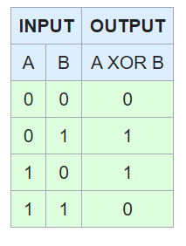
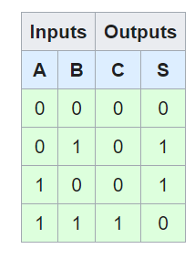
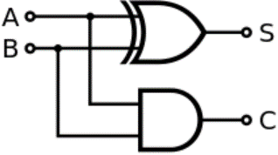

We can build a half-adder circuit with two logic gates
Half Adder “Truth Table”
Half Adder “Circuit” with XOR and AND “Gates”
Note that our FPGA (Artix7 A35T has 35000 gates inside it!)

Slide 14
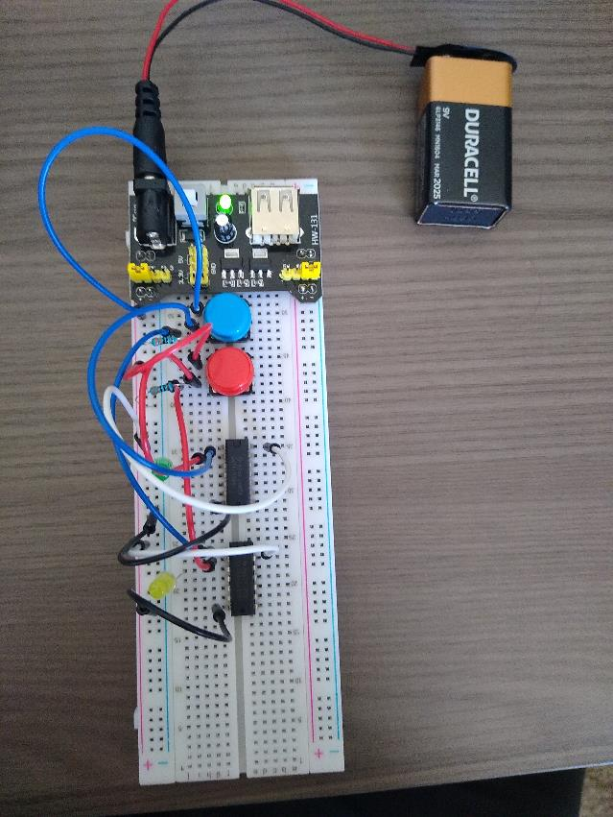
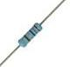


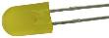

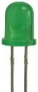
Let’s build our 5V half-adder with logic gates on a breadboard
Half Adder “Truth Table”
Half Adder “Circuit” with XOR and AND “Gates”
B = Blue
(0 = unpressed, 1 = pressed)
S = Yellow
(0 = unlit, 1 = lit)
+5V
GND
330Ω
GND
+5V
GND
330Ω
GND
A = RED
(0 = unpressed, 1 = pressed)
5V
(col
with +)
C = Green
(0 = unlit, 1 = lit)
GND (col with “-”)

Slide 15
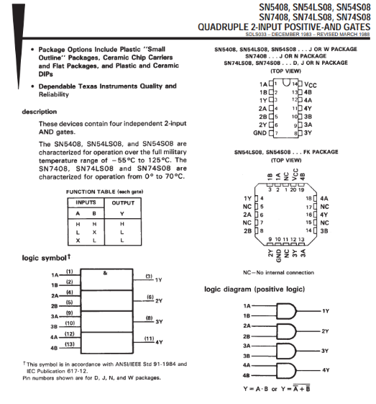
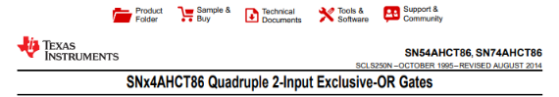
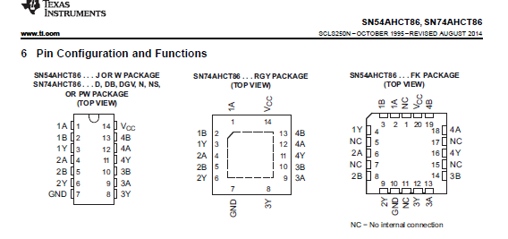
Datasheets show pin connections for the “gates” in our half adder
AND Gate
Datasheet
XOR Gate Datasheet

Slide 16
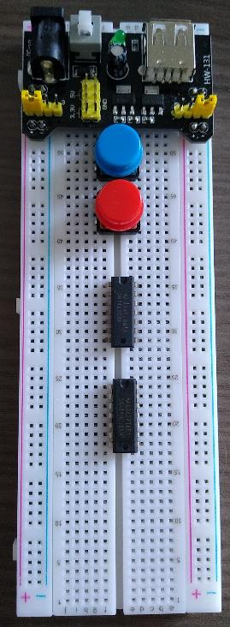
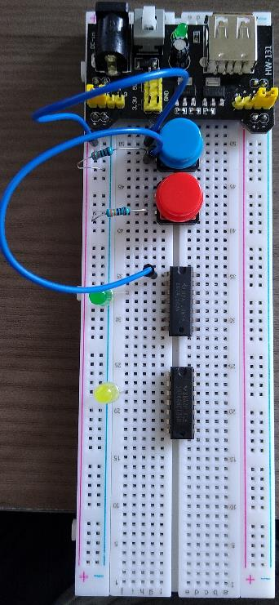
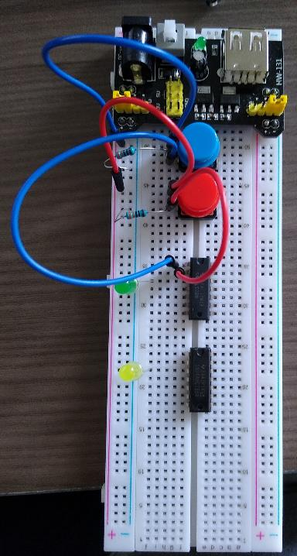
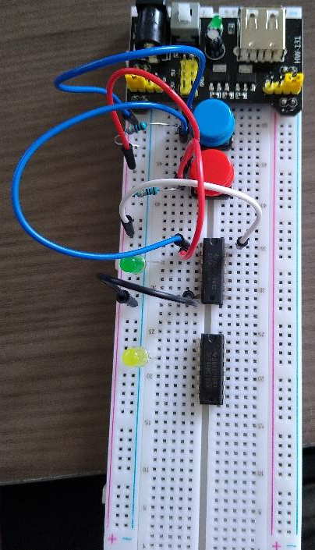
Project 1: Assemble breadboard
Power
Supply
Pushbuttons
resistors
SN74LS08
“AND Gate”
LEDs with “long side” in 5V column
SN74AHCT86
“XOR Gate”
5V “+” column
0V “-”
column
2) Add blue wires, LEDs, and 330 ohm resistors
3) Add red wires to blue button and 330Ω resistor
4) Add black wire to “0V” and white wire to “5V”
1) Place components on breadboard

Slide 17
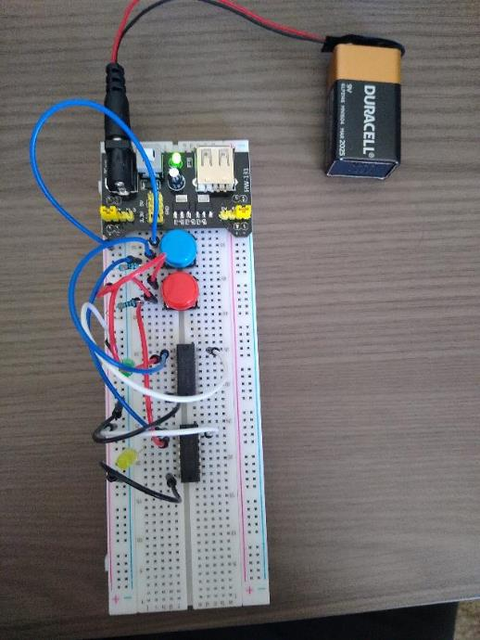
Project 1: Assemble breadboard
5) Connect blue, red, white, black wires to XOR gate. Connect 9V battery to power supply

Slide 18

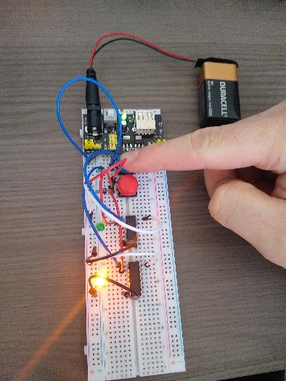
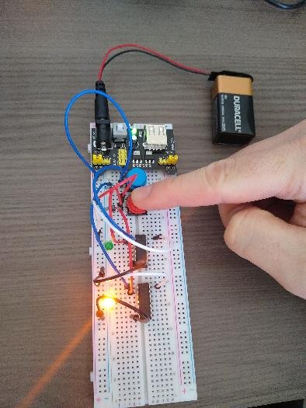
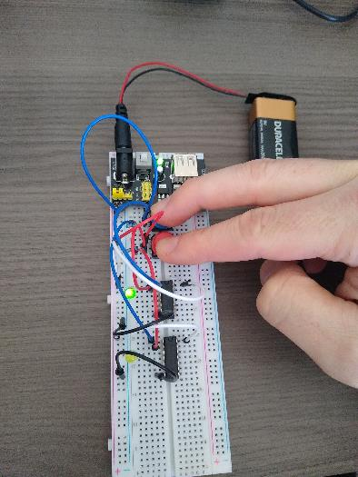
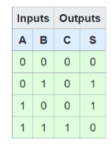
Let’s test our half-adder breadboard solution
Inputs: A=0,B=0 outputs: C=0,S=0
Inputs: A=1,B=0 outputs: C=0,S=1
Inputs: A=0,B=1 outputs: C=0,S=1
Inputs: A=1,B=1 outputs: C=1,S=0
Half Adder “Truth Table”

Slide 19
Introduction to FPGAs Lecture 2: Design/Simulate FPGA Design with Vivado
Adam Duncan

Slide 20
Vivado and FPGA Design 101
Xilinx Vivado a software program used to design, program, simulate your FPGA.
We write a code in a hardware description language (HDL) like Verilog to specify the intended hardware behavior of the FPGA.
Vivado compiles the Verilog and automatically places logic gates inside the FPGA to realize the intended FPGA functionality.
Vivado produces a bitstream file that is loaded into the physical FPGA to configure the FPGA behavior.

Slide 21
Verilog 101: Verilog, module, assign
A Verilog module is a hierarchal block in Verilog within input/output ports
An assign statement performs assignments and arithmetic operations on ports and wires within a module.
module top(
output LED
);
assign LED = 1;
endmodule

Slide 22
Vivado 101: XDC files
Xilinx Vivado a software program that turns Verilog into a bitstream file that can configures the hardware behavior of an FPGA.
Xilinx design constraints (XDC) files map FPGA physical pins to Verilog top-level module ports.
set_property PACKAGE_PIN U16 [get_ports {LED}]
set_property IOSTANDARD LVCMOS33 [get_ports {LED}]

Slide 23
Project 2: Create half adder Vivado project from scratch
0) Open Vivado and create new project with default options
1) New Project
Click “Do not specify sources at this time”
2) Select Part “xc7a35ticpg236-1L”
Project 2 Goals:
Use Vivado to create an FPGA design
Use Vivado to program your FPGA design
Follow steps outlined in below link if needed: https://users.wpi.edu/~rjduck/Basys3%20Vivado%20Decoder%20Tutorial.pdf

Slide 24
Project 2: Create half adder Vivado project from scratch
3) create design file “top.v”
module top(
input A, // input port
input B, // input port
output SUM, // output port
output CARRY // output port
);
assign SUM = A ^ B; // bitwise xor
assign CARRY = A & B; // bitwise and
endmodule
4) create constraints file “top.xdc”
set_property PACKAGE_PIN V17 [get_ports A] set_property IOSTANDARD LVCMOS33 [get_ports A] set_property PACKAGE_PIN V16 [get_ports B] set_property IOSTANDARD LVCMOS33 [get_ports B] set_property PACKAGE_PIN U16 [get_ports SUM] set_property IOSTANDARD LVCMOS33 [get_ports SUM] set_property PACKAGE_PIN E19 [get_ports CARRY] set_property IOSTANDARD LVCMOS33 [get_ports CARRY]
Follow steps outlined in below link as needed https://users.wpi.edu/~rjduck/Basys3%20Vivado%20Decoder%20Tutorial.pdf

Slide 25
Program half adder bitstream FPGA on BASYS3
Open “Hardware Manager” in Vivado
Click “Program Device”
Select “top.bit”from “~/WHS/Projects/student_p1.runs/impl_1“ or equivalent directory
After FPGA is programmed toggle SW0,SW1
You should see LED0,LED1 toggle
Toggle SW0,SW1 to activate LED0,LED1

Slide 26
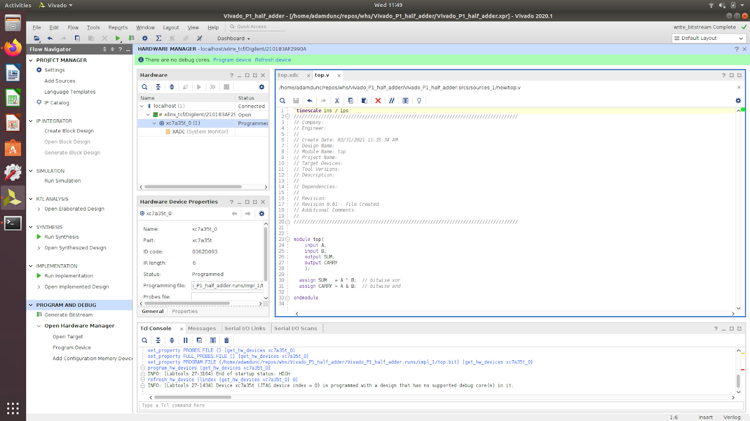
Half adder Vivado Project View

Slide 27
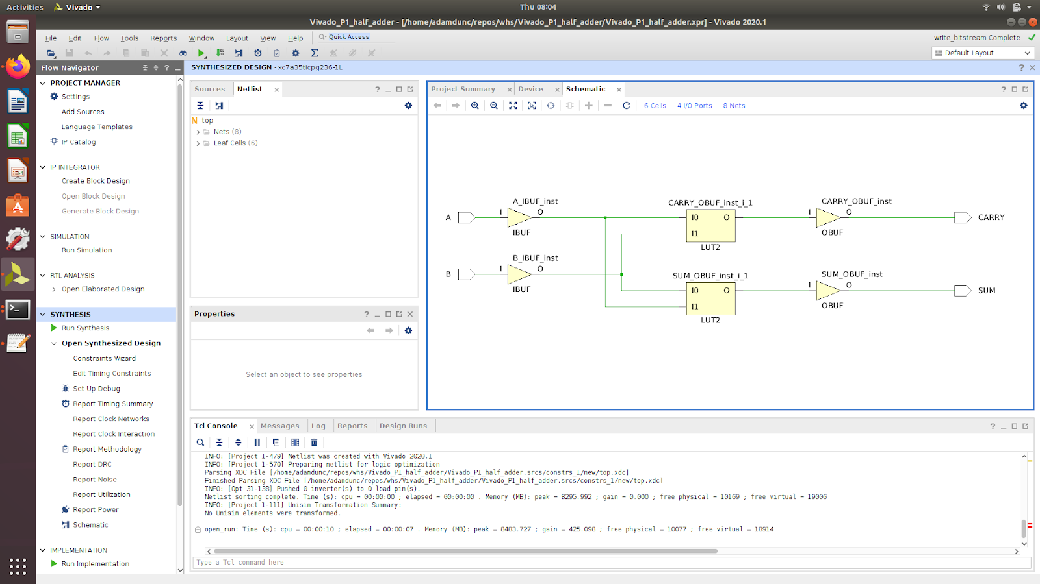
Open Synthesized Design to see “logic gate” usage
Logic Gates

Slide 28
FPGA 101: Simulations
FPGA simulations allow you to control and observe the behavior of your Verilog code.
Simulations are useful for assessing performance and debugging.
Simulations allow you to control/observe signals internal to the circuit running on the FPGA.

Slide 29
Verilog 101: Testbenches
A Verilog testbench is an HDL file that instantiates a Verilog module to simulate its behavior.
Testbench uses Verilog code to stimulate the module being tested.

Slide 30
Project 3: Simulate your half adder
0) Open your half adder Vivado project
Create simulation source “tb_top.v”
Add code as directed in the Project 3 README
Project 3 Goals:
Use Vivado to simulate an FPGA design
Follow steps outlined in below link if needed: https://users.wpi.edu/~rjduck/Basys3%20Vivado%20Decoder%20Tutorial.pdf

Slide 31
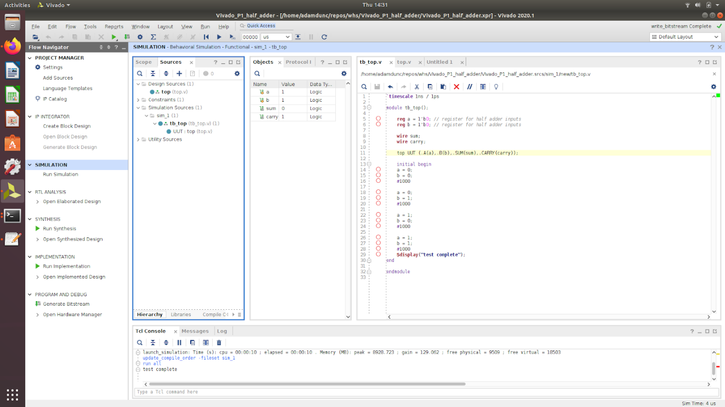
Project 3: Create tb_top.v testbench file and simulate

Slide 32
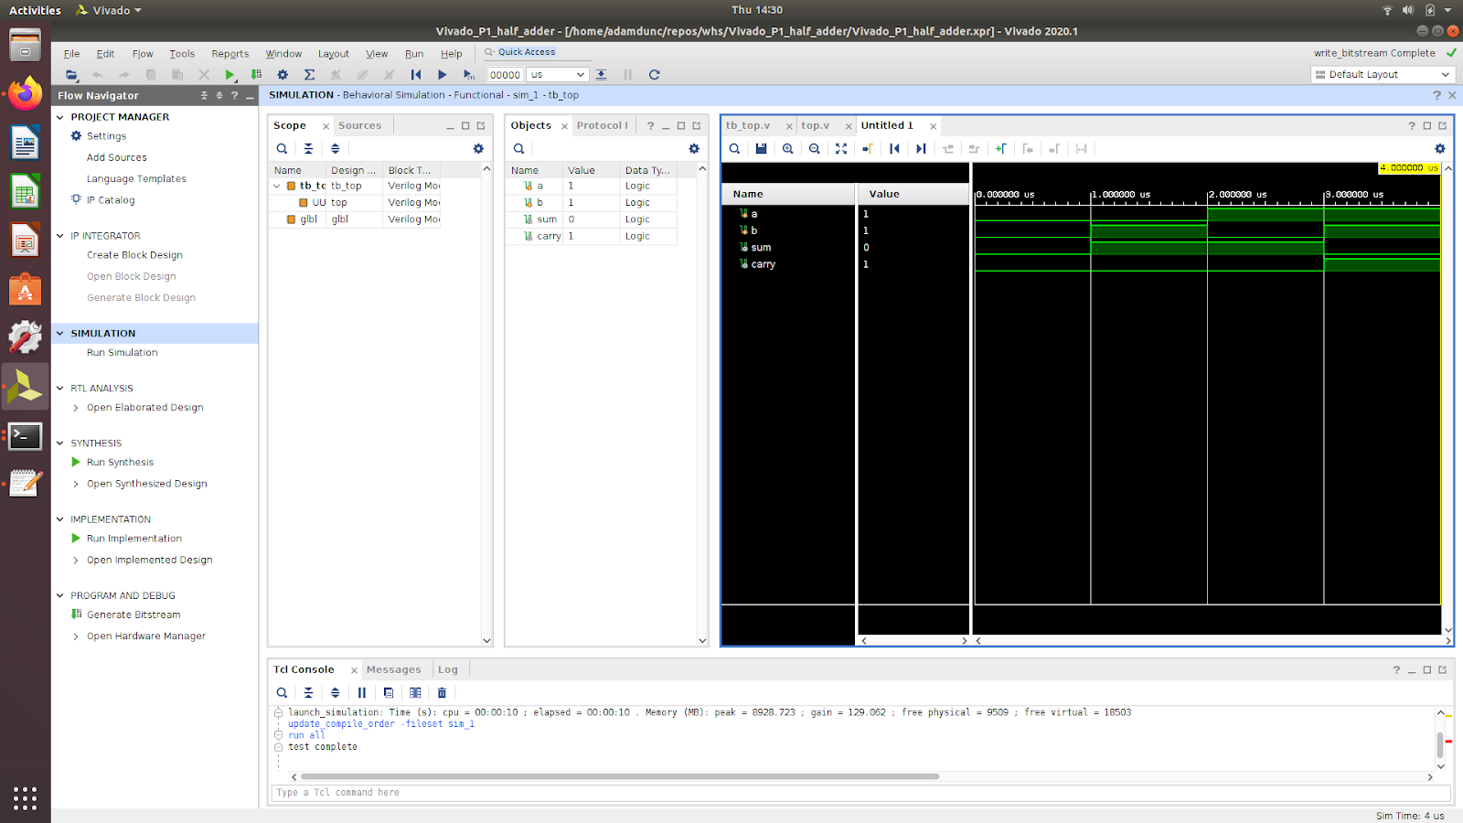
Run Vivado “Simulate”

Slide 33
Project 4: Design/Simulate/Program your FPGA to be a calculator
Add code as directed in the Project 4 README
See github/adamdunc/whs for README
Project 3 Goals:
Learn useful Verilog syntax and features
Utilize 7-segment LEDs
Follow steps outlined in below link if needed: https://users.wpi.edu/~rjduck/Basys3%20Vivado%20Decoder%20Tutorial.pdf

Slide 34
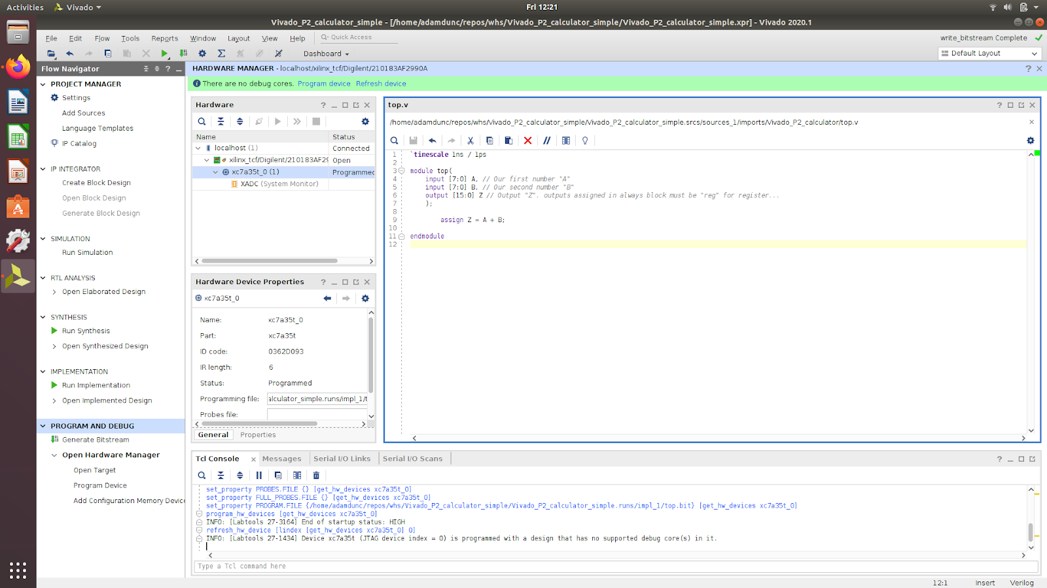
Project 4 Step 1: Design/Simulate Calculator

Slide 35
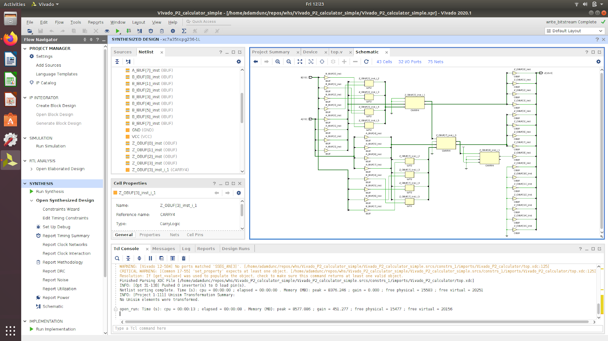
Project 4 Step 2: Note increased logic gate usage

Slide 36
Verilog 101: always, reg
An always block executes any time the contents within its parenthesis toggle.
A reg is a register
module top(
input [7:0] A, input [7:0] B, output reg [15:0] Z
);
always @ (*)
begin
if (btnU == 1)
Z = A + B;
else if (btnL == 1)
Z = A / B;
end
endmodule

Slide 37
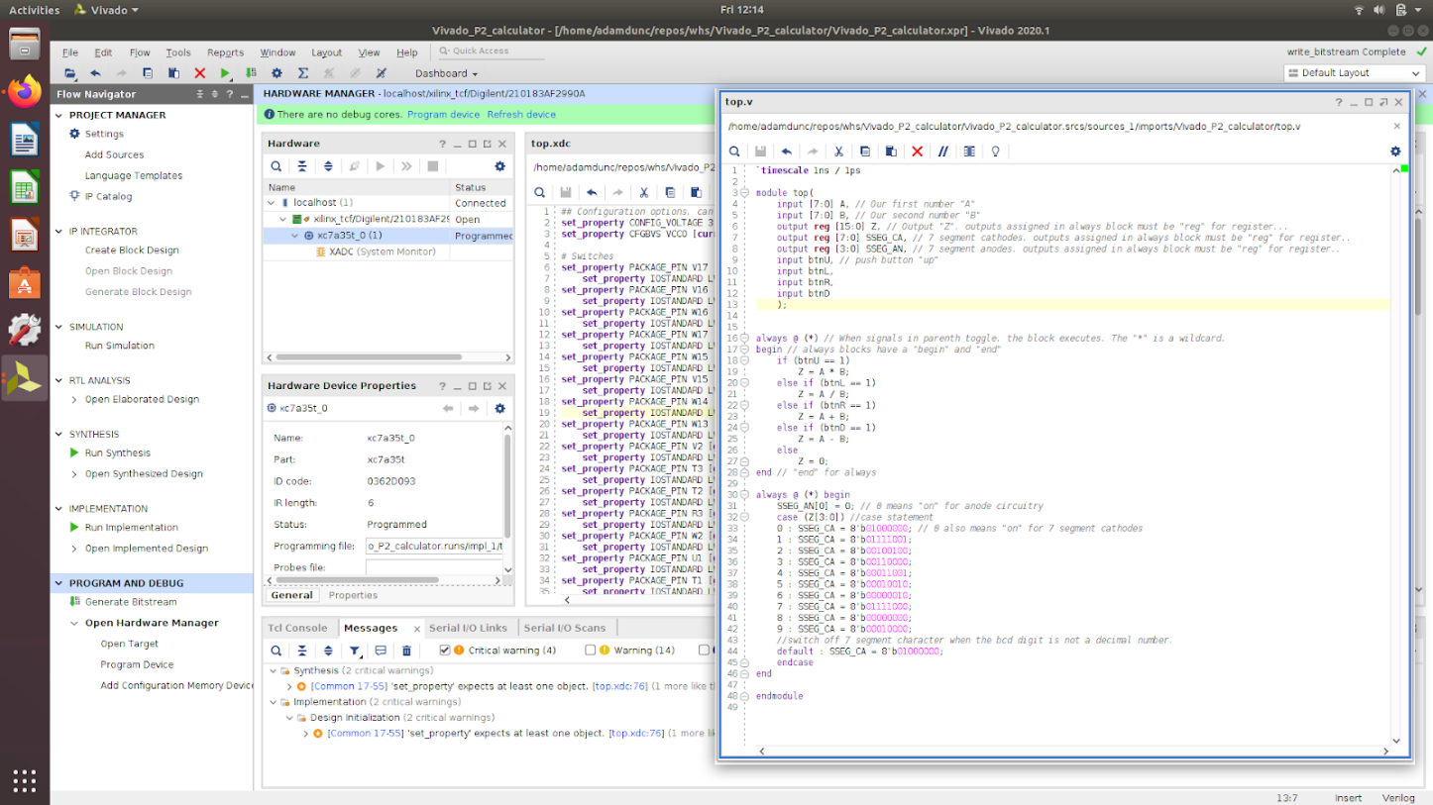
Project 4 Step 3: Modify calculator to include always block to select more operands

Slide 38
Introduction to FPGAs Lecture 3: Sequential Logic, UART
Adam Duncan

Slide 39
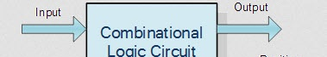
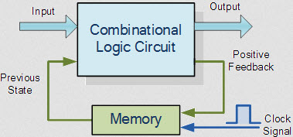
Sequential logic 101: Clocks and Memory
Combinational: output toggles after input (No memory)
Sequential: output toggles with input, previous state, and clock signal edge (Memory)
https://www.elprocus.com/tutorial-on-sequential-logic-circuits/

Slide 40
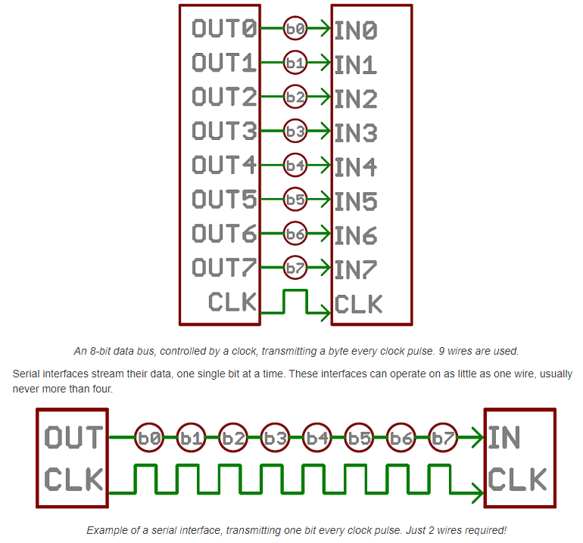
UART 101: Parallel versus Serial
https://learn.sparkfun.com/tutorials/serial-communication/all

Slide 41
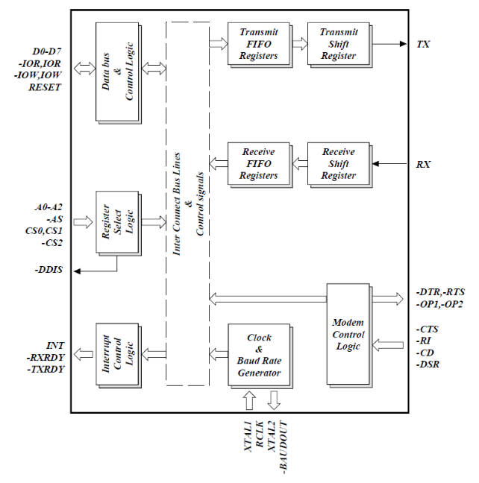
UART 101: Hardware blocks to convert between serial and parallel data
8 bit parallel
1 bit serial
1 bit serial
https://learn.sparkfun.com/tutorials/serial-communication/all

Slide 42

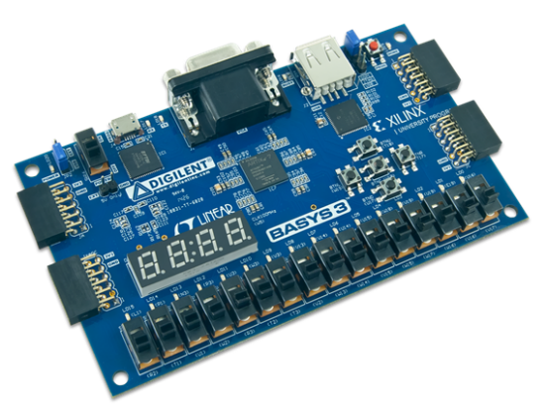
Project 5: Design/(simulate)/Program FPGA to function as UART to communicate with PC
2) ASCII “1” sent serially over USB to FPGA
3) FPGA receives ASCII “1”, and sends it back to PC
4) ASCII “1” sent serially over USB back to PC
1) User presses “1” on PC keyboard
See github/adamdunc/whs for README
Project 5 Goals:
Communicate with FPGA from PC
Experience sequential logic and UARTs
https://github.com/alexforencich/verilog-uart/

Slide 43
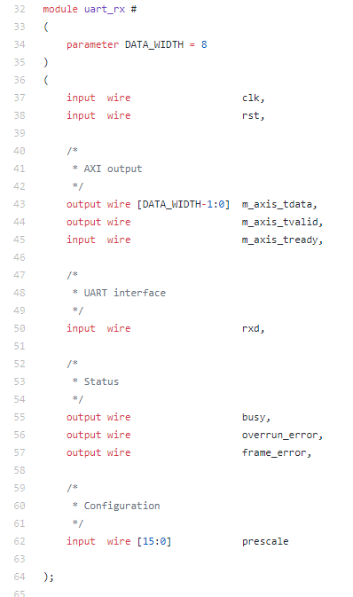
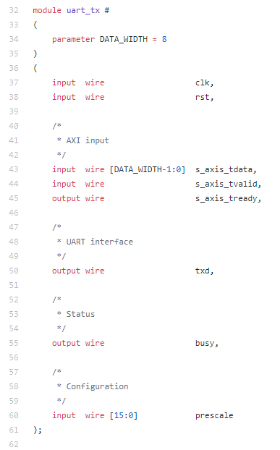
Project 5 Step 1: Instantiate “uart_rx” and “uart_tx” modules
See github/adamdunc/whs for README
https://github.com/alexforencich/verilog-uart/

Slide 44
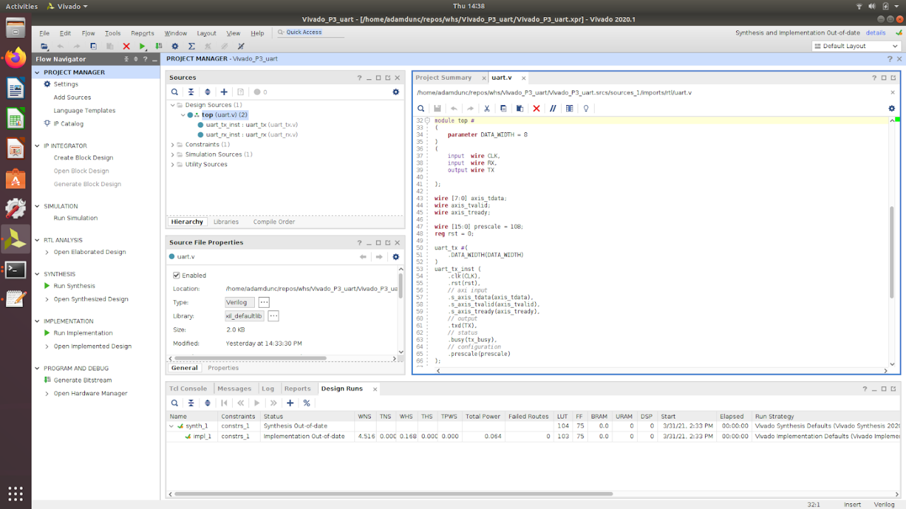
Project 5 Step2: Connect UART RX and UART TX modules together with axis_tdata, axis_tvalid, axis_tready

Slide 45
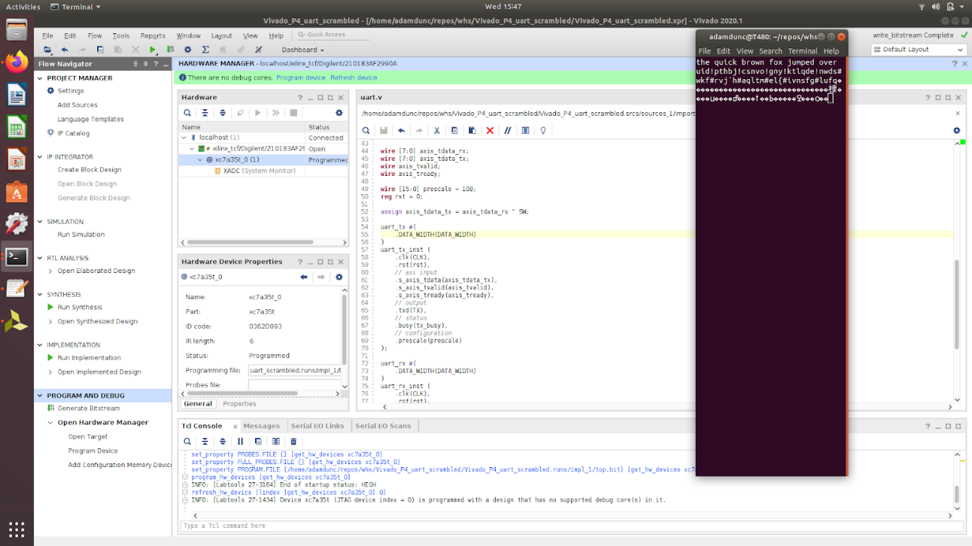
Project 5 step 3: Add logic inside FPGA to “modify” the ASCII values inside the FPGA

Slide 46

Project 6: Generate Basic “Pong” Game
Open Project 6 Vivado Pong project
Add Verilog to drive VGA output from FPGA
(See README for specific files and lines to add)
Generate bitstream
Program bitstream on FPGA
Connect VGA output from FPGA board to monitor
Use “left” and “right” keys to control paddle
We will use this as the base for our final project!
See github/adamdunc/whs for README
Project 6 Goals:
Build simple Pong game on FPGA
Customize Pong with your group!
https://www.fpga4fun.com/PongGame.html

